Slide 1

CMPE 285 - SOFTWARE ENGINEERING PROCESSES
FALL - 2021
TERM PROJECT- STOCK PORTFOLIO SUGGESTION ENGINE
TEAM MEMBERS:
SUJATHA NADIMPALLI - 014686113
ANNMARY SEBASTIAN - 015215928
ZEEL J SONI - 015337465
HANISH PUNAMIYA - 015271971
GUIDED BY: RICHARD SINN

Slide 2
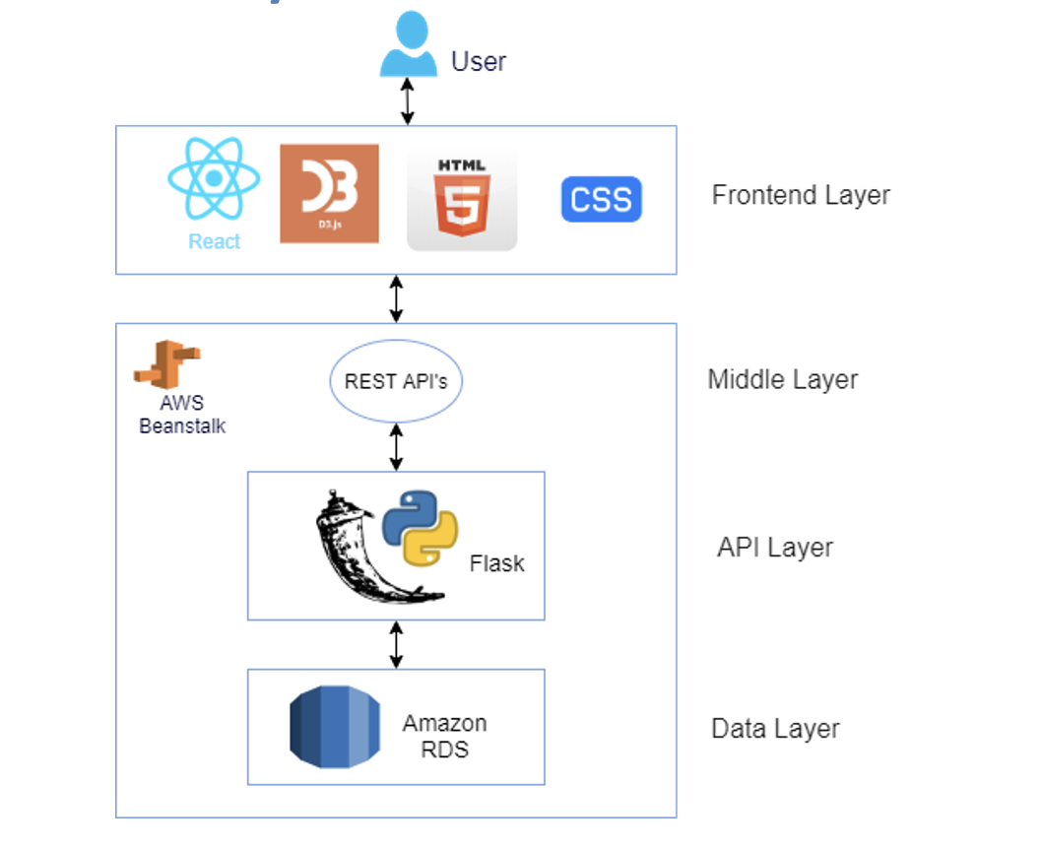
SYSTEM ARCHITECTURE
Local

Slide 3
FEATURES
Stock suggestions are made based on the amount invested and the investment strategy
Details such as number of stocks, holding value and portfolio diversity ratio are provided by the engine
Investment strategy and investment amount validations are done for the inputs.
The total portfolio and individual stocks weekly trends are been featured.

Slide 4
ADDITIONAL FEATURES
Sign-up and sign-in functionalities are implemented with proper security. Form validations are done for first-name, last-name, email, and password.
Real-time ticker showing the most recent stock prices.
Frontend has been developed using material UI
For 1D, 1M, 3M, 1Y, 5Y, and All time periods, the latest market trend widget includes data on Active, Gainer, and Loser Stocks.

Slide 5
CHALLENGES FACED
Simplistic user interface that is both clean and functional.
Finding a good market data API with no usage restrictions.
Creating an algorithm to distribute money across stocks based on their quantity.
Understanding the stock market and different stock investment methods

Slide 6
DEMO

Slide 7
Test Cases 1/3
S.No | Test Case | Expected
1. | Step 1: On the Sign In screen. Step 2: The user enters email address ("xyz@gmail.com") and a password (”123"), and then clicks on "sign in." | A valid error message stating that “Invalid Credentials”
2. | Step 1: On the Sign In screen, if the user clicks on "Don't have an account?", then navigate him to "SignUp" page. Step 2: The user enters the first name “Ann” and last names “Seb”, as well as an email address (”email@gmail.com") and a password (”123"), and then clicks on "sign up." | A valid error message stating that “Please try another email” appears because this email is already in use.
3. | Step 1: On the Sign In screen, if the user clicks on "Don't have an account?", then navigate him to "SignUp" page. Step 2: The user enters the first name “Ann” and last names “Seb”, as well as an email address (”annseb1@gmail.com") and a password (”annseb"), and then clicks on "sign up." | A message stating that “User has signed up successfully and redirect the user to dashboard”. A welcome message with the username has to appear on the left pane.

Slide 8
Test Cases 2/3
S.No | Test Case | Expected
4. | Step1: signed up successfully. Step2: Log out from that account.. Step3: Sign in with the credentials that are created during sign up. | The User should be signed in successfully. A welcome message should display user name and widgets will be displayed.
5. | Enter an invalid amount i.e, something below $5000 | A valid error message stating that minimum amount is $5000 should be displayed and the submit button has to be disabled.
6. | Enter a valid amount i.e, something above or equals to $5000 and do not select any strategy | Submit button has to be disabled
7. | Enter a valid amount i.e, something above or equals to $5000 and select any 3 strategies. | A valid error message stating that “Maximum 2 strategies can be picked at a time” is displayed and the submit button has is disabled.

Slide 9
Test Cases 3/3
S.No | Test Case | Expected
8. | Step1: Enter a valid amount i.e, something above or equals to $5000 and select any one strategy Step2: Click submit | The dashboard is updated with allocation data for 3 companies' stocks, as well as holding ratios. The holding ratios must add up to 100%.
9. | Step1: Enter a valid amount i.e, something above or equals to $5000 and select any two strategies Step2: Click submit | The dashboard is updated with allocation data for 6 companies' stocks, as well as holding ratios. The holding ratios must add up to 100%.
10. | Click on Log Out | The user session has to terminate and the user must be redirected to the login page.

Slide 10
Future Work
Extend the application to include a mobile version.
More live dashboards for user portfolios that update in real-time needs to be added.
Users can select to get daily portfolio value email notifications by signing up for daily email alerts.
Users' investing strategies are saved, and on their next visit, new stocks are suggested.

Slide 11
Thank You

